Slide 1
GAS (Gait Analysis System)
Making physical therapy easier for everyone
Team Members:
Zoe Fowler, Holiday Garrison, Ryan Hopson, Muammar Saeed, Chris Slagell

Slide 2
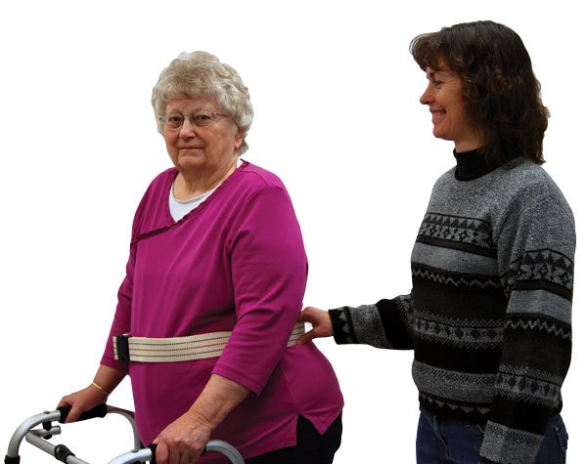
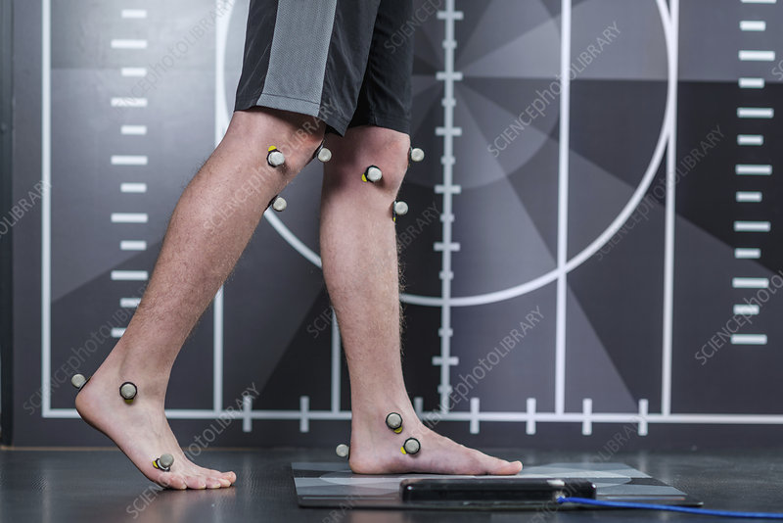
Problem
Gait analysis is an assessment performed by physical therapists
Important for correcting injuries
Pre-existing methods are either expensive or do not record data
No method to monitor patients outside therapy sessions
Difficult to see whether patient is improving
[1]
[2]

Slide 3

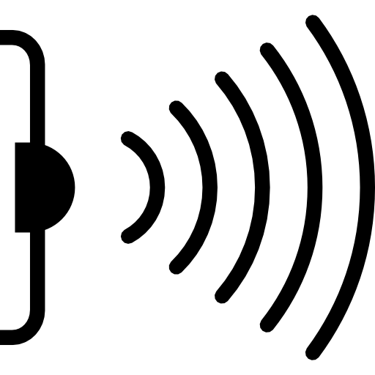

Solution
GAS is used for gait performance analysis
Comprised of a comfortable belt and two snug ankle bracelets
Uses sensors to record important walking data from the user
Physical therapists can connect to GAS via USB with no required training
Data displayed in helpful charts and graphs
[3]
[4]
[5]

Slide 4

Customer
Physical therapists
Home care professionals
Outpatient therapy
[6]

Slide 5

Marketing Strategy
Reach out to physical therapists who work in outpatient therapy
Upload simple video demonstrations
Test the product with various users
Offer a free trial period for outpatient therapy companies
[7]

Slide 6
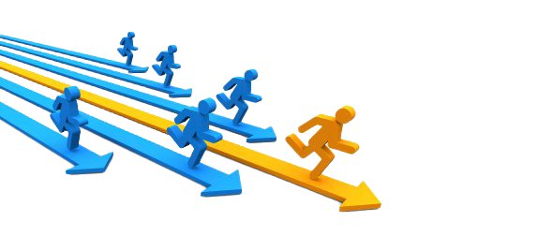
Competitive Advantage
There is no inexpensive, convenient technology to analyze gait
GAS provides a hands-off approach to track user progress
Users are only tasked with turning the device on and off
Users wear the device exclusively during therapy walking sessions
[8]

Slide 7
Image Credits
“MRI Non-Magnetic Transfer / Gait Belt.” https://www.ocelco.com/store/pc/MRI-Non-Magnetic-Transfer-Gait-Belt-p13096.htm [Accessed 08/30/2020].
“Markers for gait analysis.” https://www.sciencephoto.com/media/1014006/view/markers-for-gait-analysis [Accessed 08/30/2020].
"Woman is Walking." https://creazilla.com/nodes/22293-woman-is-walking-for-exercise-clipart [Accessed 08/30/2020].
"Infrared Sensor Symbol." https://favpng.com/png_view/license-infrared-symbol-sensor-png/c6Bm1yxd [Accessed 08/30/2020].
"Computer with Positive Graph Clipart." https://www.pinclipart.com/pindetail/ihboJxb_computer-with-positive-graph-clipart/ [Accessed 08/30/2020].
“Benefits of Physical Therapy.” https://www.mdbonedocs.com/benefits-of-physical-therapy/ [Accessed 08/20/2020].
“Digital Marketing PNG Transparent Image.” http://www.pngmart.com/image/124556 [Accessed 08/20/2020].
“Competition PNG HD.” http://www.pngmart.com/image/158799 [Accessed 08/23/2020].

